Slide 1

Understanding variability in response to therapy across patients with colorectal cancer metastasizing to liver
Adam Wojtulewski
Moffitt Cancer Center
Machine Learning Department
Karolak Lab

Slide 2
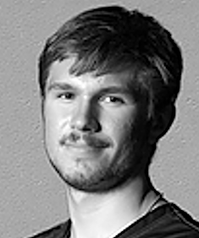

About me
Adam Wojtulewski
Completed International Baccalaureate (IB) Program at Palm Harbor University High School in May 2021
Third year undergraduate at the University of Florida (UF); graduate December 2024
Major in Computer Science and Minor in Artificial Intelligence
President of the Polish Student Association (POLSA) at UF
Took this internship opportunity to have a hands-on application of machine learning approaches
LinkedIn QR Code

Slide 3
Understanding the problem
Colorectal cancer (CRC) is the second leading cause of cancer related mortality in men and women combined
About 30% of CRC patients develop liver MS
Patients have a very poor overall survival (OS) rate of as low as 15% at 5-years
Effective chemotherapy agents and novel systemic therapies improve these numbers
However, there is a high inter- and intra-tumoral heterogeneity
Moreover, patients with similar mCRC features still respond differently to treatment

Slide 4
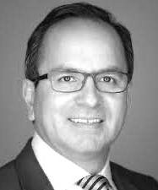
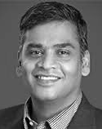
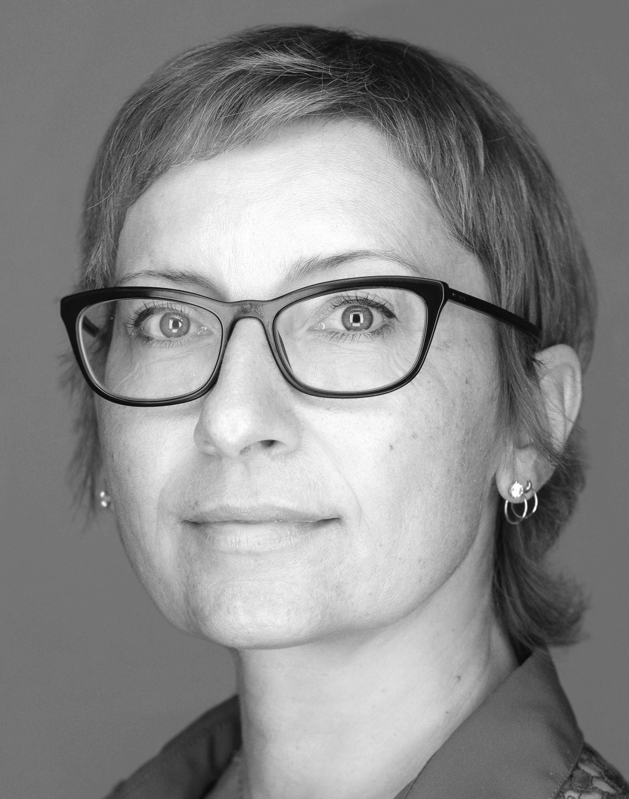
What needs to be researched
There is an urgent need to understand the variability in response to therapy across patients with similar cancer features
Can we predict response to therapy by integrating clinical, morphologic, and molecular factors (collaboration: Anaya, Balagurunathan, and Karolak)
The goal of this study is to take the first step and understand the variability in response using public sequencing data

Slide 5
Materials and methods
Datasets
Data Pre-processing
Data visualization
K-Means Clustering
Random Forest Classifier
Artificial Neural Networks
Model verification

Slide 6


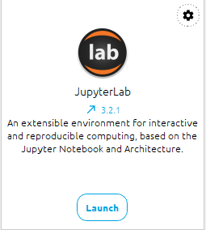
Running my code
Integrated Development Environment (IDE)
Github QR Code
https://www.anaconda.com/download/
https://github.com/AdamWojtul28/Moffitt-Data-Analysis

Slide 7
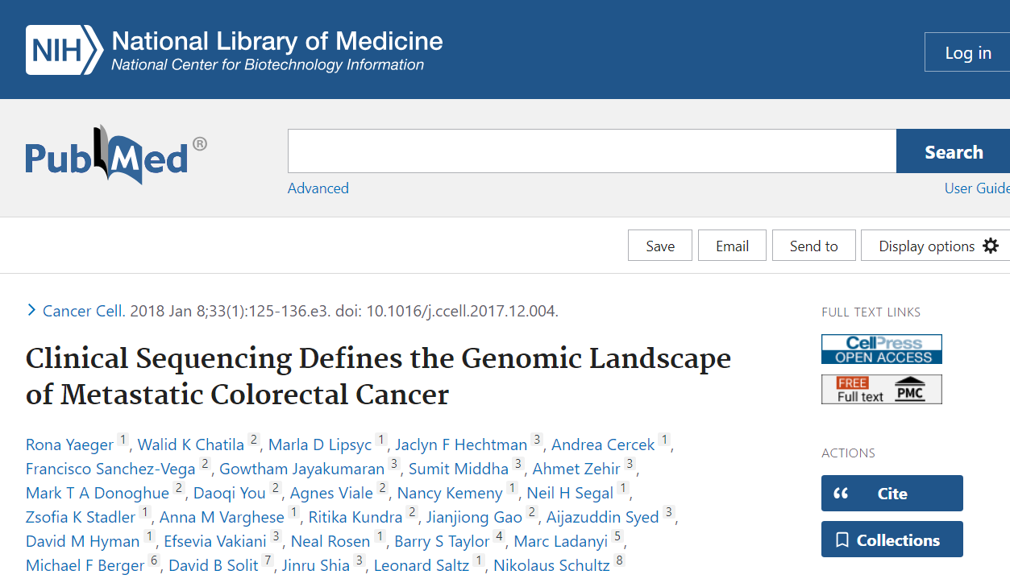
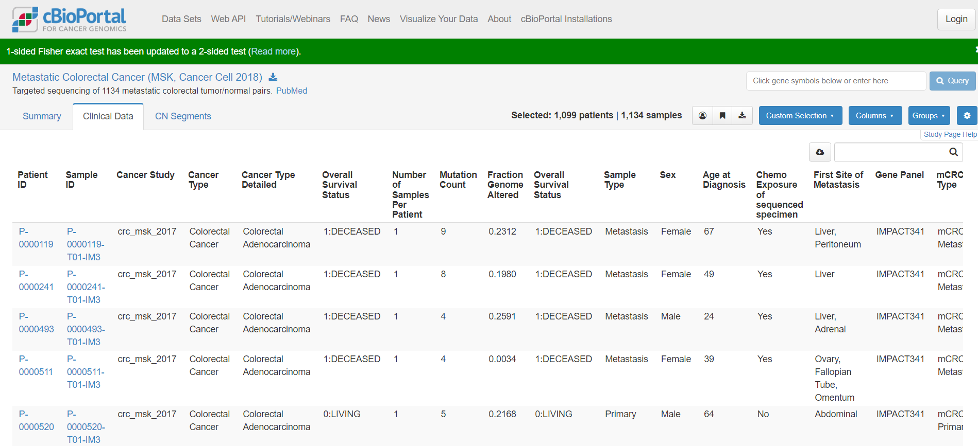
Datasets

Slide 8
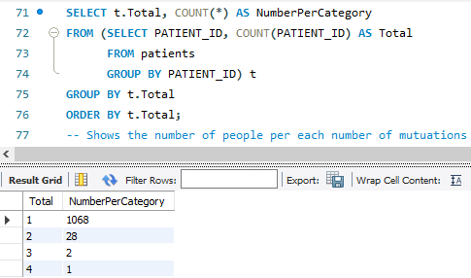
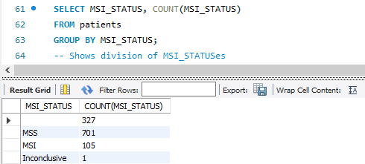
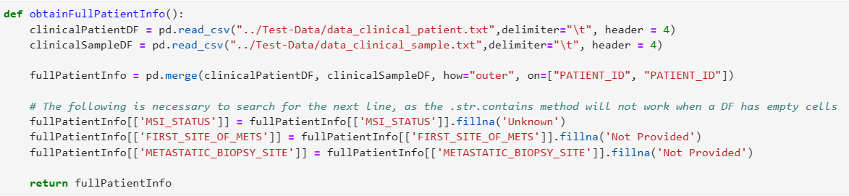
Data Pre-processing (Part 1)
Understanding the datasets
Deciding which tables to use
Deciding which columns to use
Merging data tables
Eliminating blank cells

Slide 9
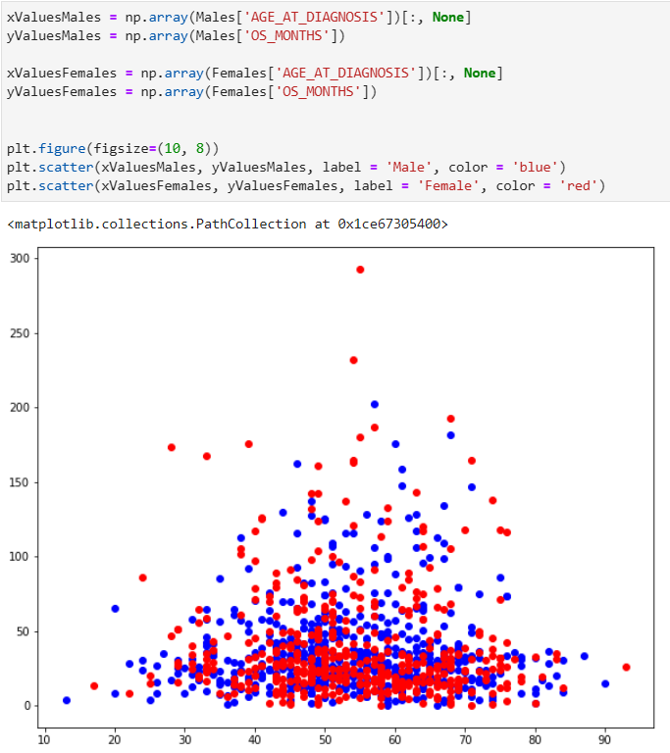
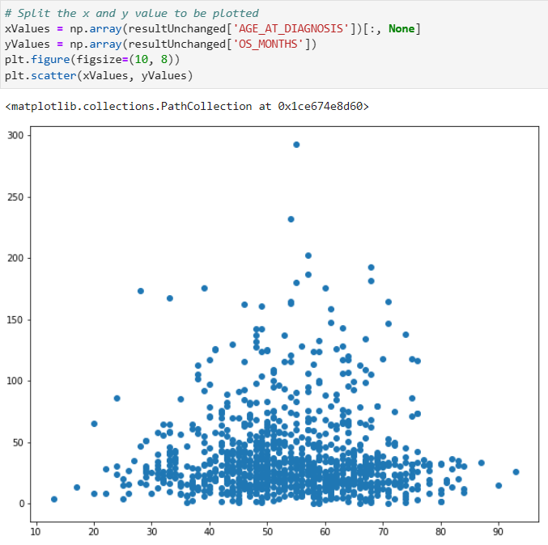
Data visualization: Pyplot
Basic form of visualization
Used to potentially visualize general trends on the entire dataset as a whole
Manually split dataset according to desired needs

Slide 10
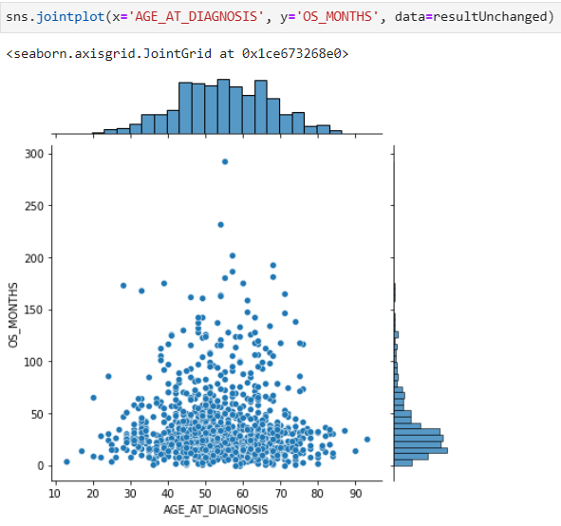
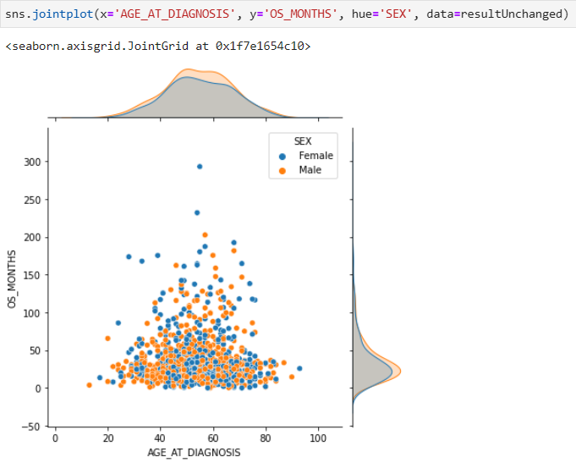
Data visualization: Seaborn
More advanced form of visualization
Used to create more complex graph types
Dataset can be split using the parameters in the graph
Eliminates need for manually splitting data

Slide 11
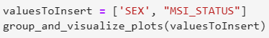
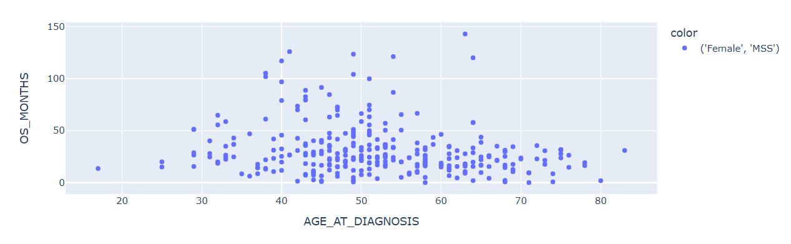
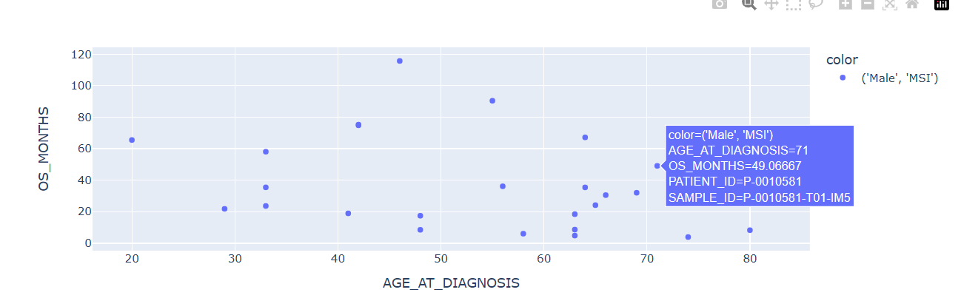
Data visualization: Plotly
Previous 2 approaches have drawbacks:
Neither produces interactive plots
To much data
Function that incorporates Plotly:
Splits data according to parameters
Produces interactive plots for each group

Slide 12
How K-Mean Clustering Works
An n number of centroids are randomly assigned on a plot
Every point is assigned to the nearest cluster
Cluster is recomputed by taking the average position of all of the points in the cluster
Algorithm repeats steps 2 and 3 until either the centroids do not change from iteration to iteration, or the upper limit of iterations is reached

Slide 13
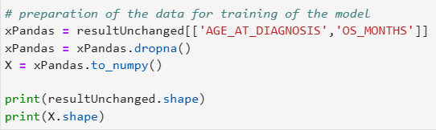
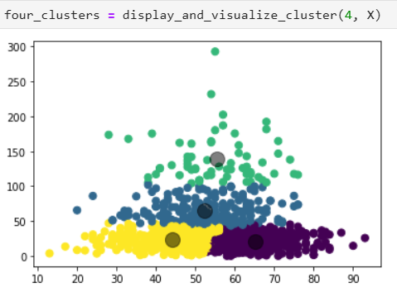
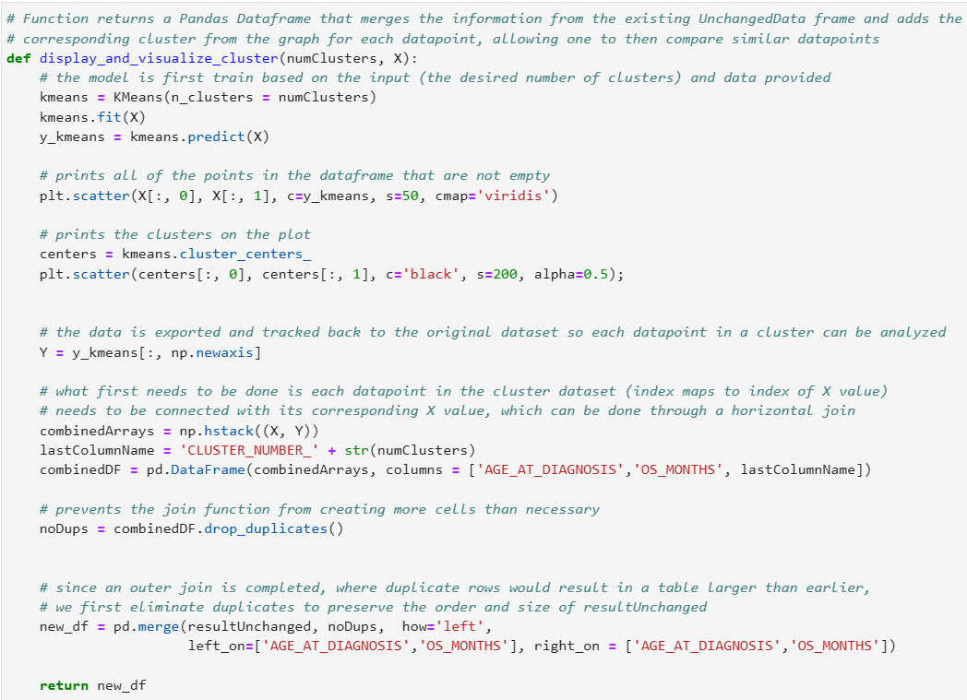
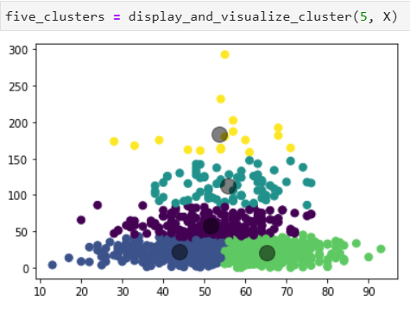
K-Means Clustering

Slide 14
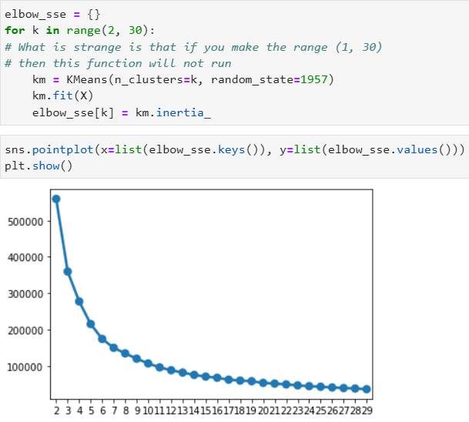
K-Means Clustering
Function developed appends cluster number to original dataset
The patients in each cluster can be compared for similar traits
Combining this function with elbow plot (right) can suggest proper number of clusters to use
Would yield more significant results to this approach
Heuristic approach
3-7 Clusters should be tested

Slide 15
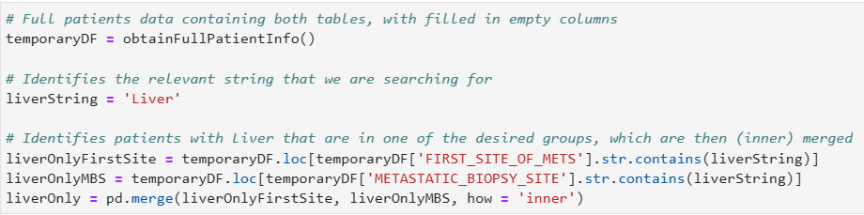
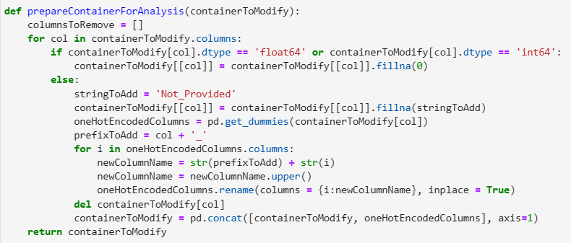
Data Pre-processing (Part 2)
Learning about new dataset with drug data
Isolating only Liver MS patients
Filling empty values
One-Hot Encoding string columns
Creating training and testing data

Slide 16
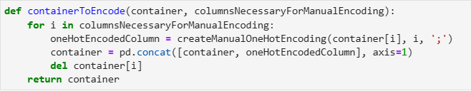
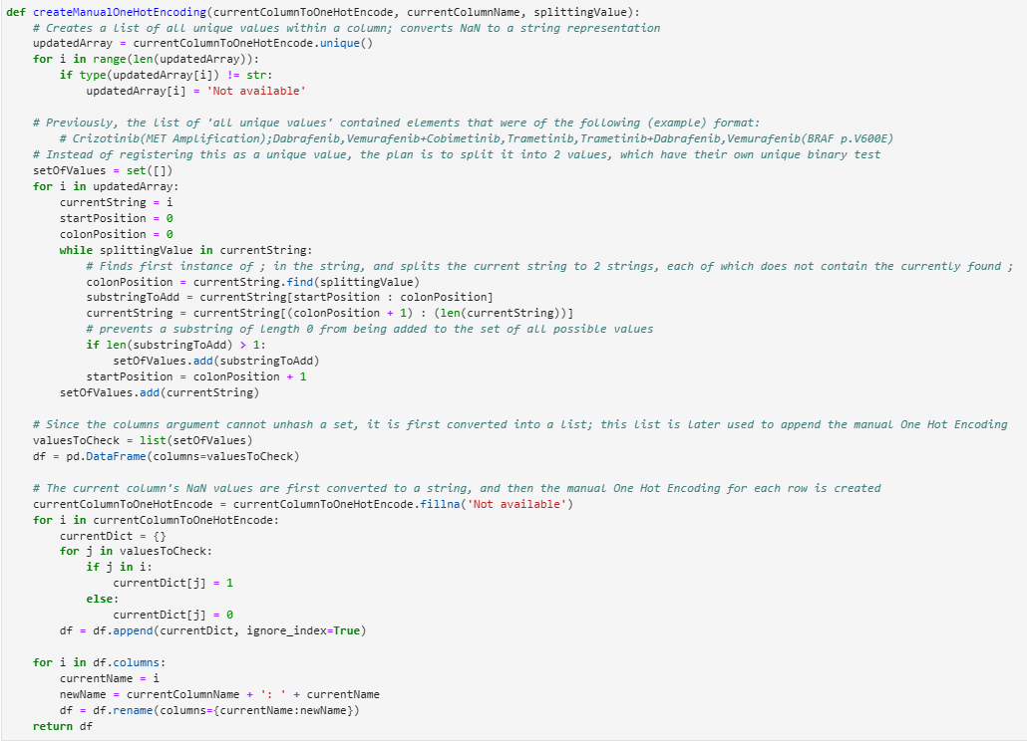
Data Pre-processing (Part 2)
Outliers/anomalies in data:
Character delimited cells
Would result in inaccurate One-Hot Encoding
Examples would include a cell like
Crizotinib(MET Amplification);Dabrafenib,Vemurafenib+Cobimetinib,Trametinib,Trametinib+Dabrafenib,Vemurafenib(BRAF p.V600E)
Each exist as individual treatment

Slide 17
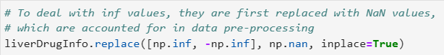
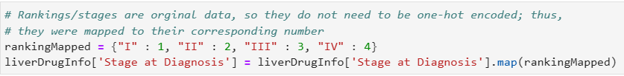
Data Pre-processing (Part 2)
Outliers/anomalies in data:
Infinity values
Would result in an array of NaN for ANN output
Ordinal data or binary mappings
Stage at Diagnosis
Roman Numerals
Vital Status
2 separate columns that could be concatenated to 1

Slide 18
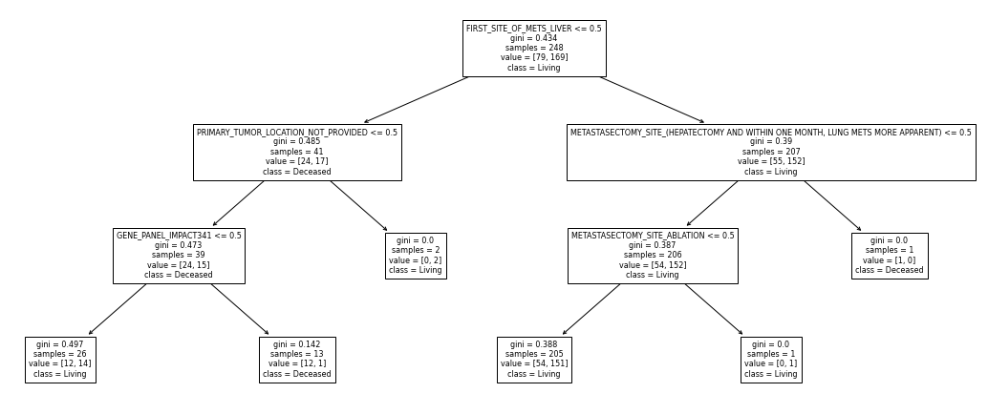
How Random Forest Classifiers Work
True
False
Leaf Node

Slide 19
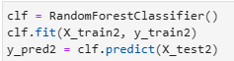
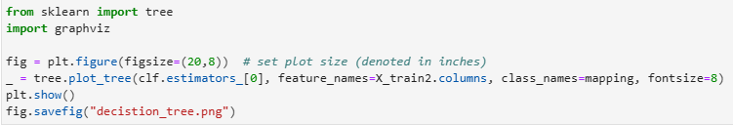
Random Forest Classifier
Allows prediction of phenomena based on training/testing data
3 main models completed, which vary based on y-value:
OS Months predicted
Without drug info
Vital Status predicted
Without drug info: 58-84%
With drug info: 74-77%

Slide 20
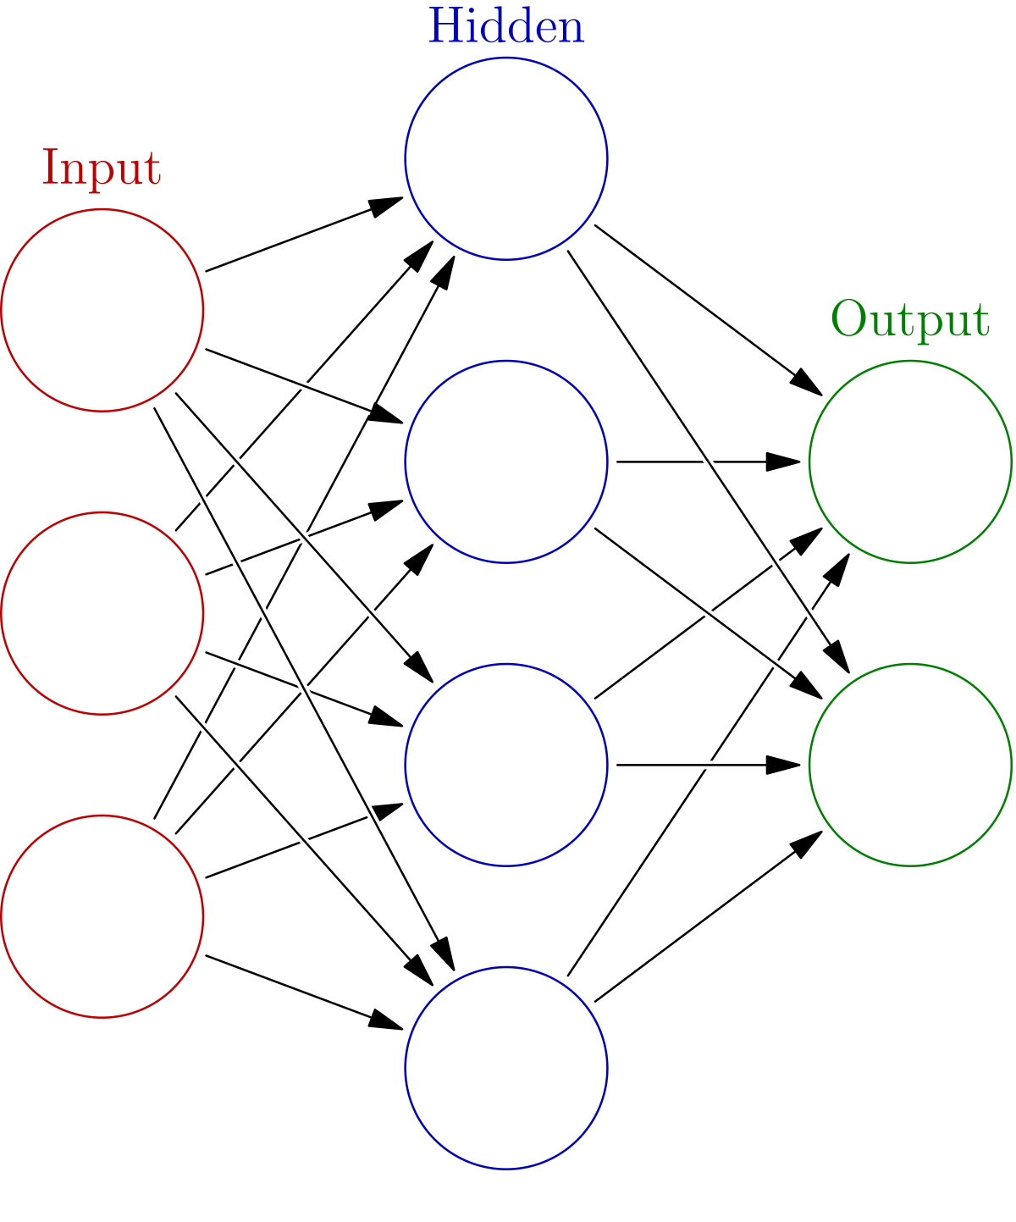

How Neural Networks Work
https://en.wikipedia.org/wiki/Artificial_neural_network
https://medium.com/@shrutijadon/survey-on-activation-functions-for-deep-learning-9689331ba092

Slide 21
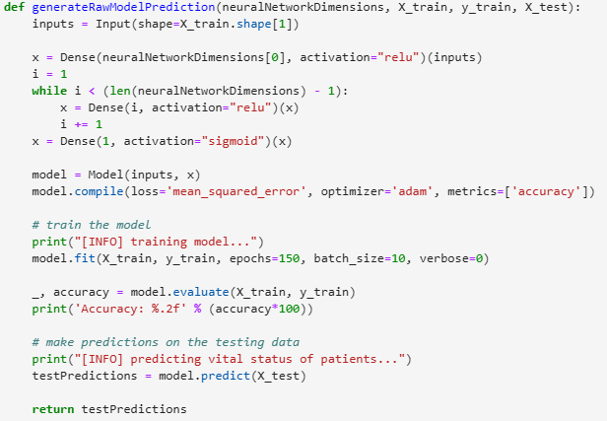
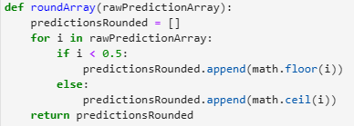
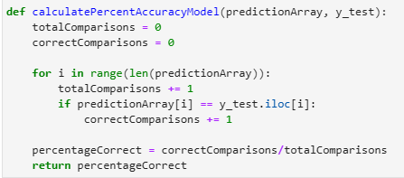
Artificial Neural Networks (Deep Learning)
Created a function to make a neural network with the architecture specified for any container
Last layer always uses sigmoid with one output
Every other layer uses a ReLU function
ADAM optimizer
Subsequent functions round output and display percent accuracy

Slide 22
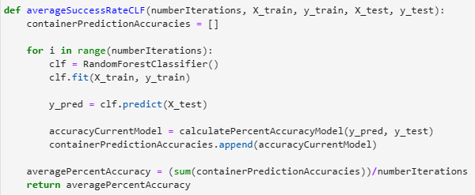
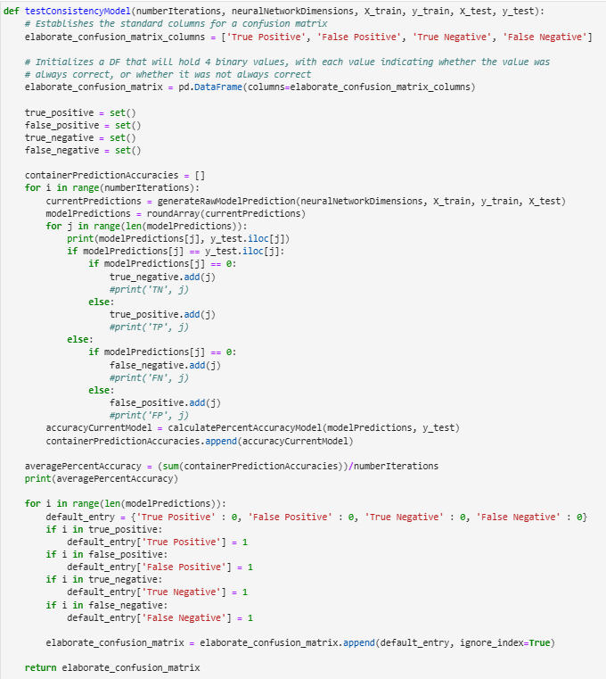
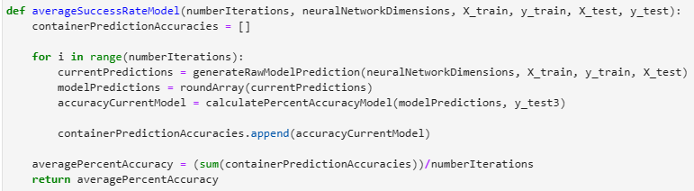
Model verification
Average accuracy of model function
Elaborate Confusion Matrix Function

Slide 23
Results from average accuracy functions
Average Percent Accuracy of RF Models
Average Percent Accuracy of ANN Models
Percentage Correct Predictions (after 25 iterations)
ANN Architecture | W/o Drug Info | W Drug Info
2 - 1 | 0.5206 | 0.7355
4 – 1 | 0.5162 | 0.7627
8 – 1 | 0.5168 | 0.7527
16 – 1 | 0.5054 | 0.7333
32 – 1 | 0.4978 | 0.7314
64 – 1 | 0.4946 | 0.7219
128 – 1 | 0.5000 | 0.7249
3 – 3 – 1 | 0.5105 | 0.7135
3 – 5 – 1 | 0.5156 | 0.7208
3 – 7 – 1 | 0.5162 | 0.7178
3 – 9 – 1 | 0.5217 | 0.7107
3 – 11 – 1 | 0.5130 | 0.7064
Without drug info: 58-84%
With drug info: 74-77%
Verdict:
The latter’s consistency makes it the superior model upon first glance

Slide 24
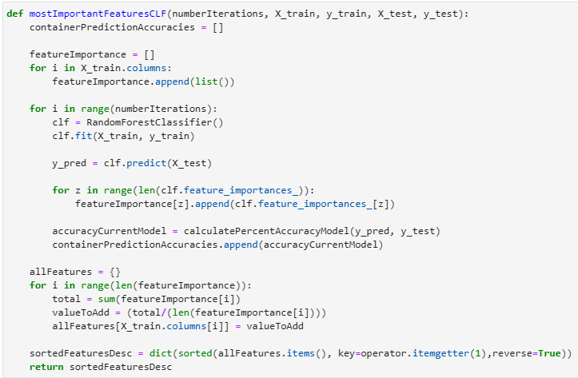
Results from feature importance calculations
Rank | Column Name | Percent Importance
1 | Survival Date of mets to date of death or last FU for mCRC (months)' | 0.064767
2 | Time from Met Dx to Sequencing' | 0.060251
3 | Average Sample Alele Frequency' | 0.049957
4 | Fraction of Genome Altered' | 0.049921
5 | Age at Diagnosis' | 0.044515
6 | MSIsensor Score' | 0.044153
7 | Metastasectomy' | 0.0431
8 | Mutation Rate (mut/mb)' | 0.03874
9 | Ratio of Indel to Substitutions' | 0.037599
10 | MSK IMPACT PANEL_IMPACT341' | 0.019471

Slide 25
Future areas of exploration
Further implementing and analyzing feature significance
Additional verification methods for models developed
F1 Score, AUC-ROC, varying threshold, cross validation
Feature extraction and possibility of merging drug data
Transfer learning to Moffitt Data
Development of a self-learning interface to support clinical decision making

Slide 26
Acknowledgements
This internship would not be possible without three main groups:
Family
Doctor Karolak
Machine Learning Department, especially my team members
Moffitt Cancer Center

Slide 27
Thank you
Github QR Code
LinkedIn QR Code
Questions?

Slide 28
Sources Consulted
https://www.cancer.gov/publications/dictionaries/cancer-terms/def/metastasis
https://bjssjournals.onlinelibrary.wiley.com/doi/10.1002/bjs5.50341#:~:text=Metachronous%20metastasis%20was%20defined%20as,mm%20of%20the%20resection%20margin.
https://www.ncbi.nlm.nih.gov/pmc/articles/PMC3349572/#:~:text=%22Synchronous%20metastasis%22%20and%20%22synchronous,of%20the%20primary%20colon%20cancer.
https://www.ncbi.nlm.nih.gov/pmc/articles/PMC4304930/#:~:text=DNA%20polymerase%20epsilon%20(POLE)%20exonuclease,by%20The%20Cancer%20Genome%20Atlas.
https://fightcolorectalcancer.org/facing-colorectal-cancer/diagnosis-and-treatment/diagnosis/what-is-msi-and-mss/
https://bmccancer.biomedcentral.com/articles/10.1186/s12885-019-6227-7#:~:text=The%20resulting%20MSIsensor%20score%20is,percentage%20of%20mutated%20microsatellite%20loci.
https://ascopubs.org/doi/10.1200/PO.17.00011#:~:text=Level%20R1%20includes%20mutational%20events,respond%20to%20a%20standard%20therapy.
https://go.drugbank.com/drugs/DB00002

